Slide 1

What is the right to repair?

Slide 2
Why do we Need a right to repair?
Limits third-party repair capabilities
Increases repair prices
Introduces planned obsolescence

Slide 3
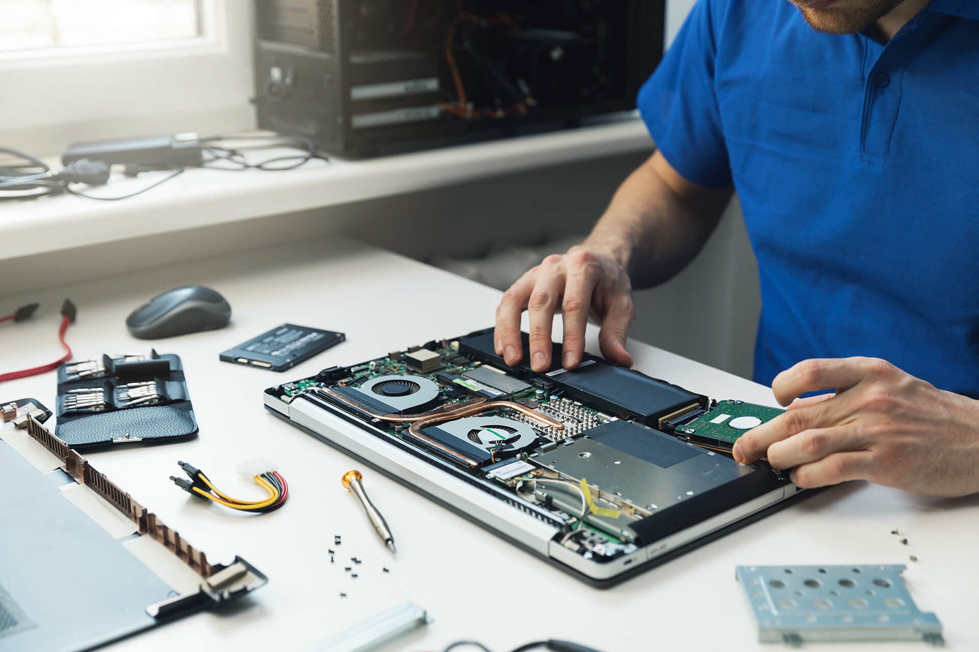

Limiting third-party repairs

Slide 4
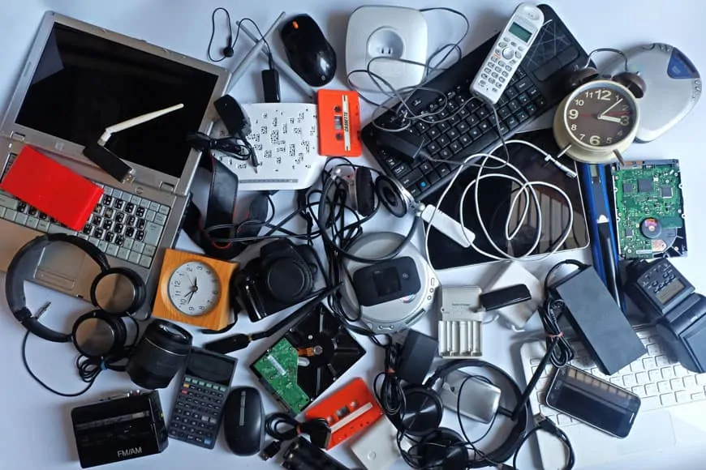

Introducing planned obsolescence

Slide 5

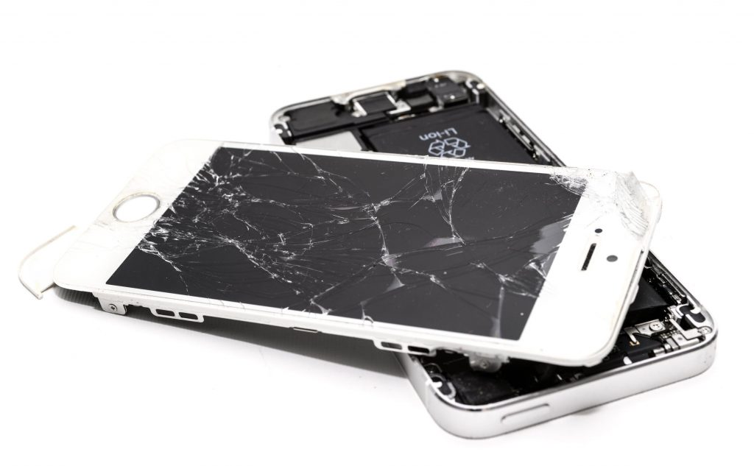
What’s stopping device repairs?

Slide 6


Why is this bad for you?

